Slide 1

Google SVN Tutorial
Ma Diming

Slide 2
Google SVN
Google SVN is a SVN server service by Google for projects and developers
Server Volume is 1GB
Stable & Free

Slide 3
Google SVN Steps
Download TortoiseSVN & Install
Log in your google account jump to more->even more->code or directly access code.google.com
Our project is named as sjtuedaacgrass, you can find it in your “My favorites” list
Click the Source Tab, and you will find the server (or we call trunk) address, copy it, or remember it
Click the “googlecode.com password” link to obtain your password, and remember it or copy it
New a folder at the place you like, name it as you want, and right click your mouse, finding a checkout menu
Click the checkout menu item, and a tortoise dialog pops up. Paste the trunk address into the address entry
New dialog for account and password will popup, enter your account name and the password acquired in previous step, remember to check the “remember…” checkbox up for never entry the tricky password again next time
Wait the tool to drag all the code down, in tortoise speed….

Slide 4
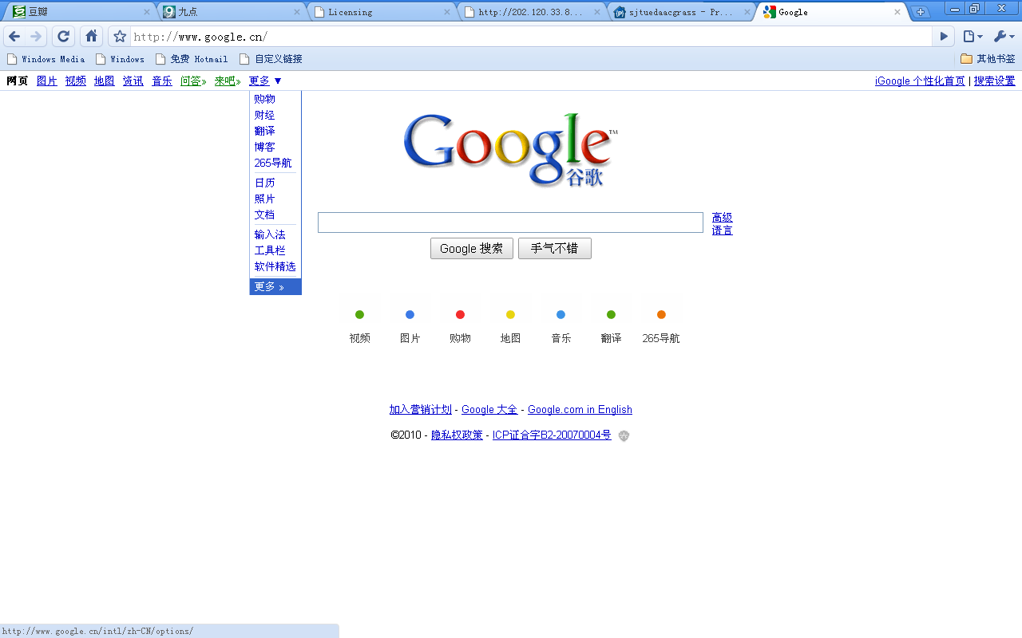
Google SVN Steps

Slide 5
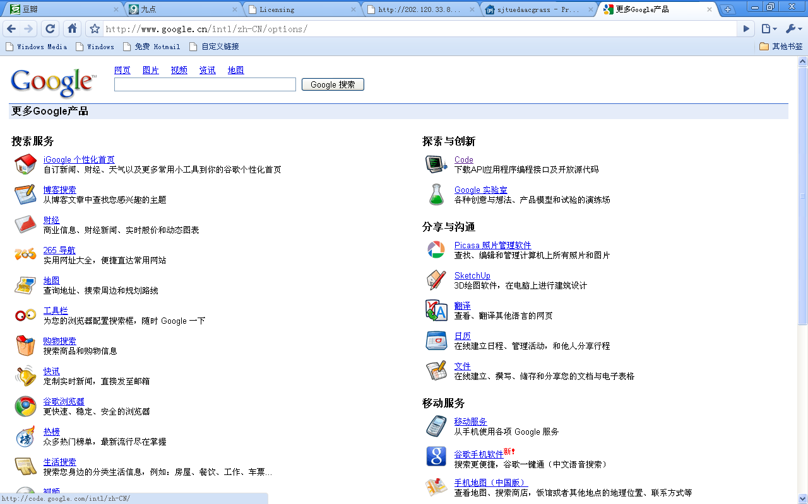
Google SVN Steps

Slide 6
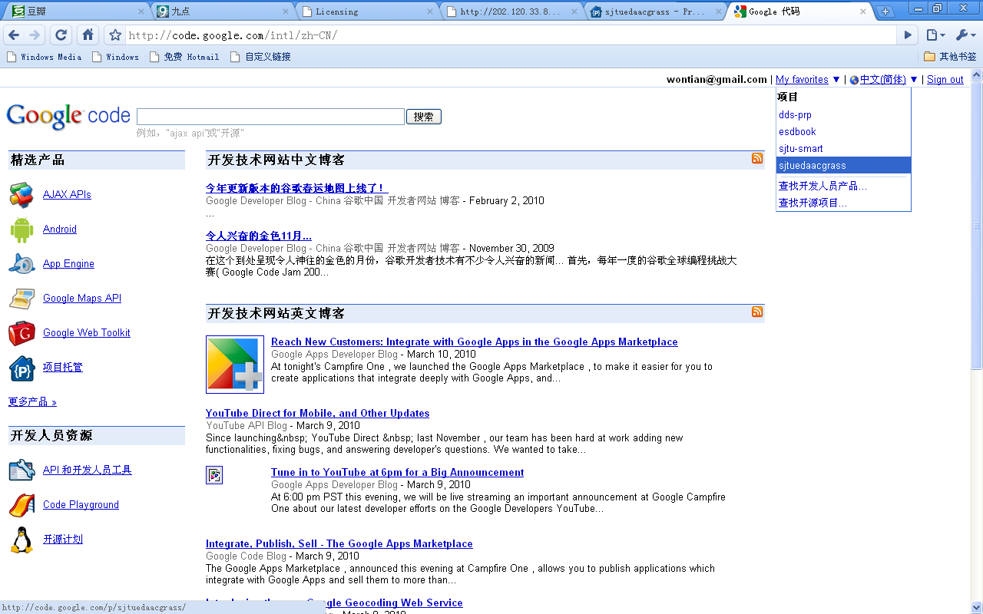
Google SVN Steps

Slide 7
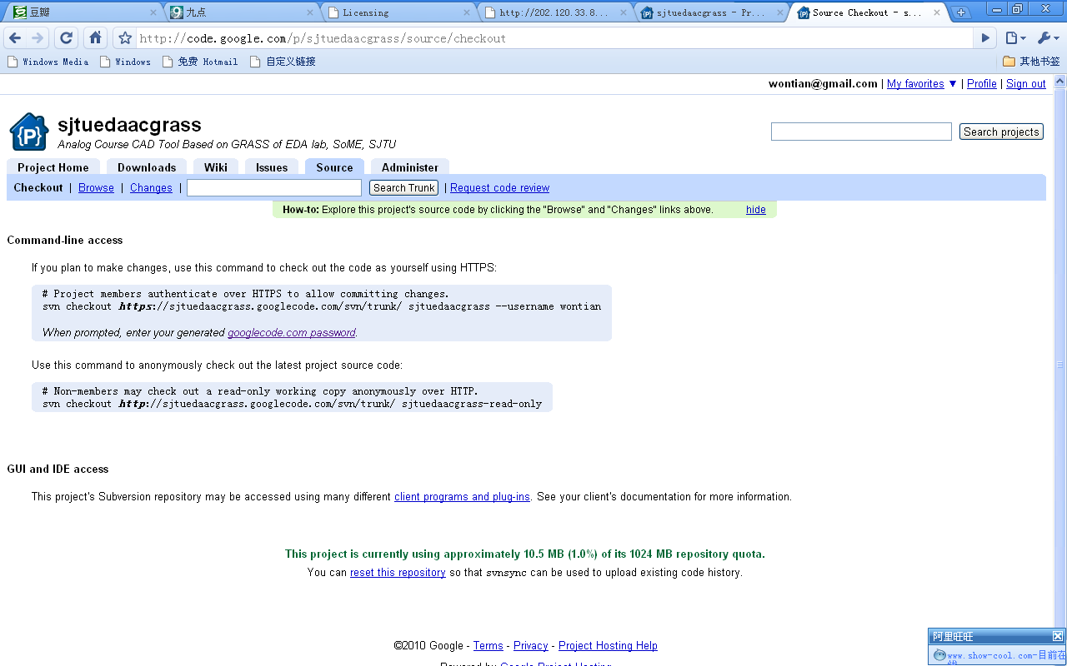
Google SVN Steps

Slide 8
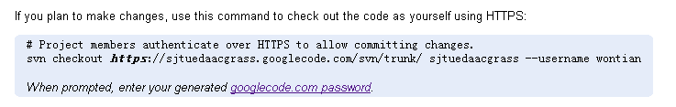
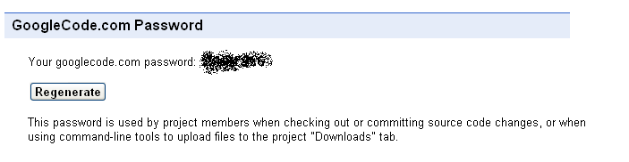
Google SVN Steps

Slide 9
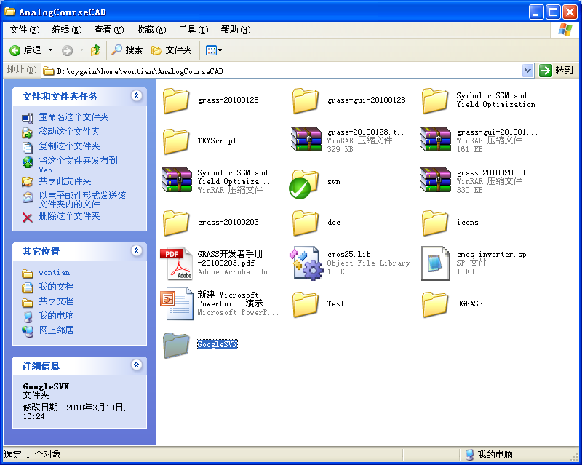
Google SVN Steps

Slide 10
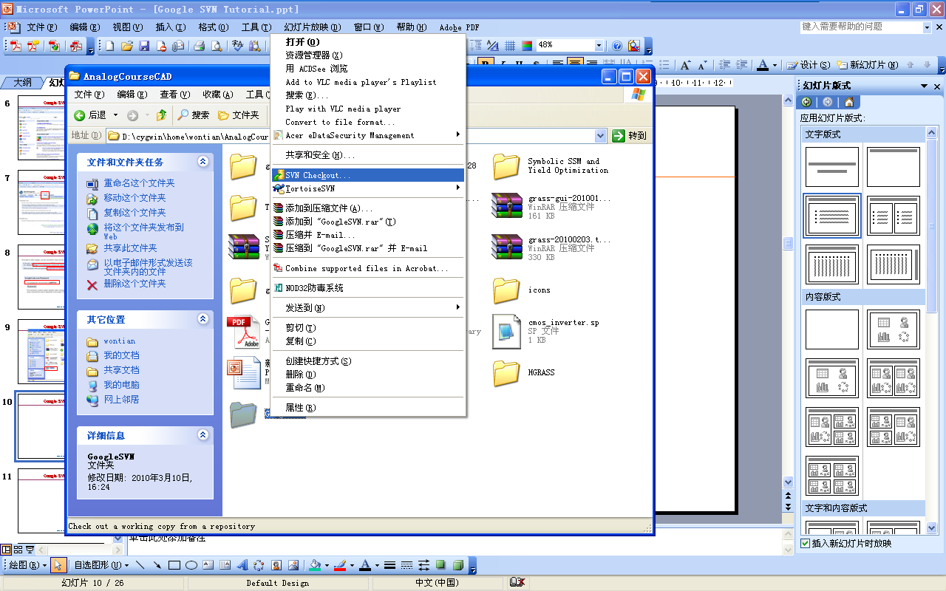
Google SVN Steps

Slide 11
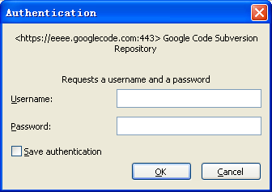
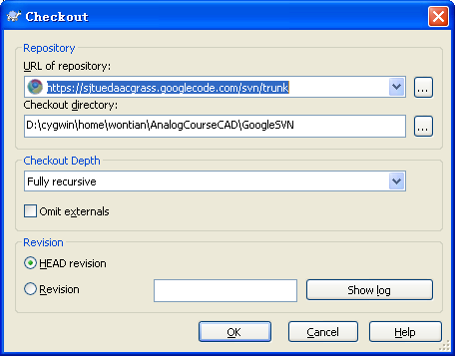
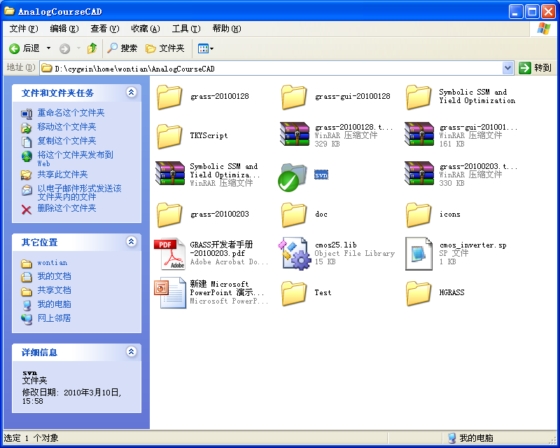
Google SVN Steps

Slide 12
Google SVN Steps
Please do all code modifications under HGRASS folder
Leave other folder untouched
Srcs can directly be Maked under HGRASS
Grass code is under $(HGRASS)/src/grass
SPADE code is under $(HGRASS)/src/spade
Script is under $(HGRASS)/script
Testcases is under $(HGRASS)/examples
Reports is under $(HGRASS)/rpt
Documents is under $(HGRASS)/doc & $(HGRASS)/README.DEV

Slide 13
Google SVN Steps
To update the newest code from trunk, right click “SVN Update”
To commit your code into trunk, right click “SVN Commit”
To patch your code, (record the modifications of your code based on the trunk), right click “tortoise svn->create patch”
To apply your patch (commit your modifications record in the patch), right click “tortoise svn->apply patch”
To add new files or directory into trunk, right click “tortoise->add”
To remove files from trunk, right click “tortoise->remove”
To revert back from previous version of code, right click “tortoise->revert”
To deal with conflicts with other people, or with the newest version of trunk, say, you and me both work on the same file, same code, we might have different ways out, conflicts take place and we have to decide which one is the better, right click “tortoise->resolve”
All the other operations please refer to right click “tortoise->”
If you are sure of your code, simply commit it, otherwise, you can create a patch and send the patch to me for review, and apply it later

Slide 14
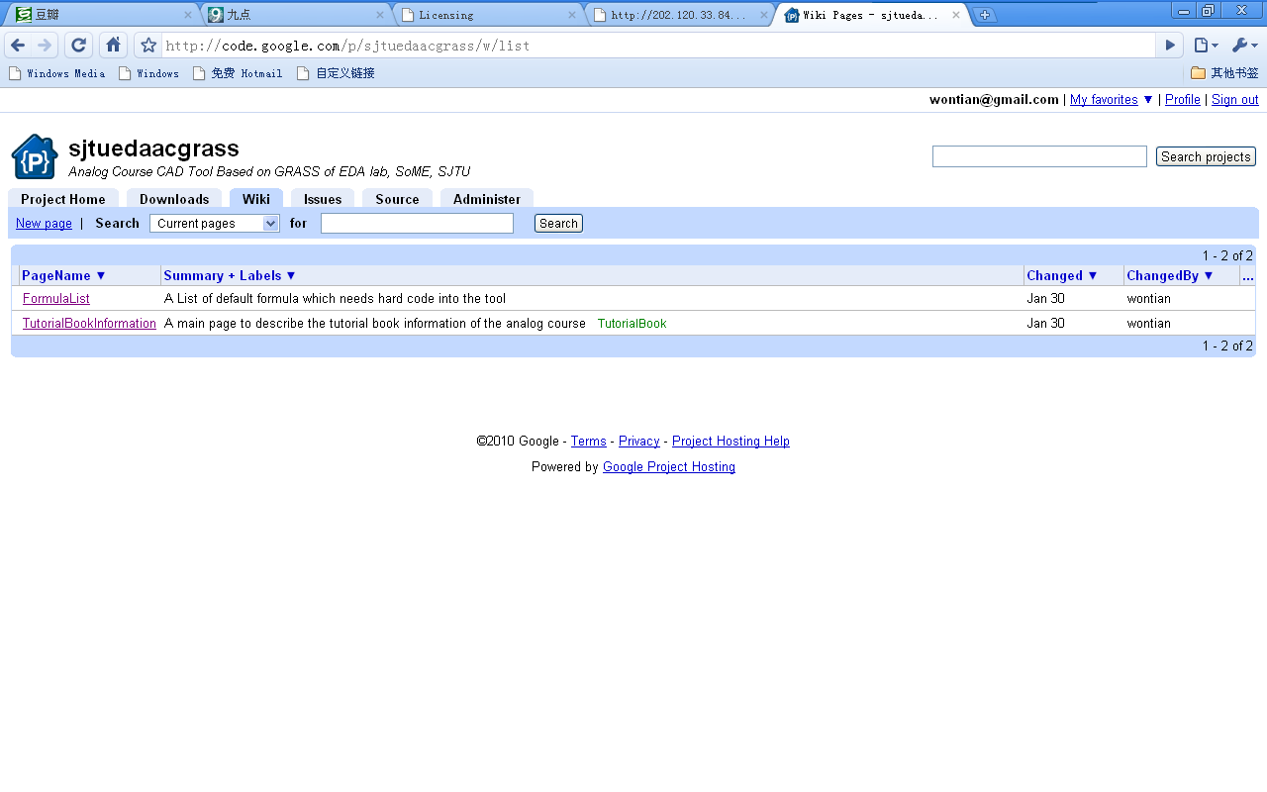
Google SVN Steps
Google has also offers good project management webpage
  Wiki, everyone can create wiki for funny things and for documents sharing
    Currently, wiki has 2 items, one is the text book of class of alex Lee, the other is the formula list for stage one I collected

Slide 15
Google SVN Steps
Any Problem plz. Contact Me
madiming@ic.sjtu.edu.cn
Thank You

